Slide 1
ACMA Azure Infrastructure
Draft
15/11/2022

Slide 2
Operational State

Slide 3
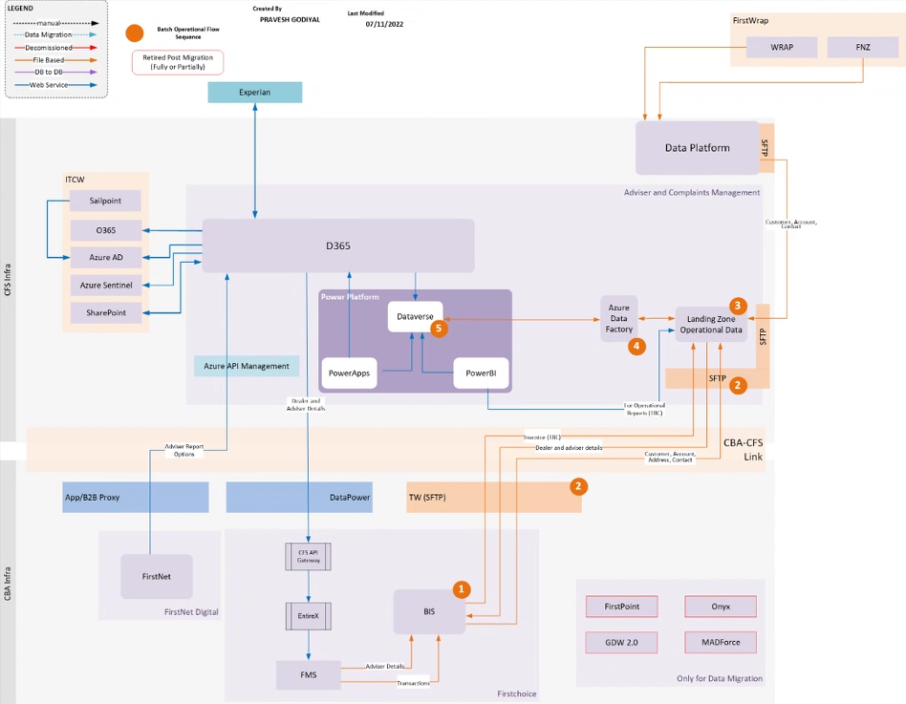
Overview
This flow to be reviewed. Likely a direct connection as they are both inside the VDC
Notes:
For applications with no active DR requirements, it is possible to specify EDC resources only. SDC resources can be added later if required.
Subnets can be specified at any size between /29 (Azure minimum) and the Vnet size. /24 is recommended for manageability. Further microsegmentation can be achieved through NSGs.
The GitHub project and repo is provisioned once and covers both Production and Non-Production tenants
Subscription level AD groups are intended for service principals only – user/dev RBAC should be set at the resource group level

Slide 4
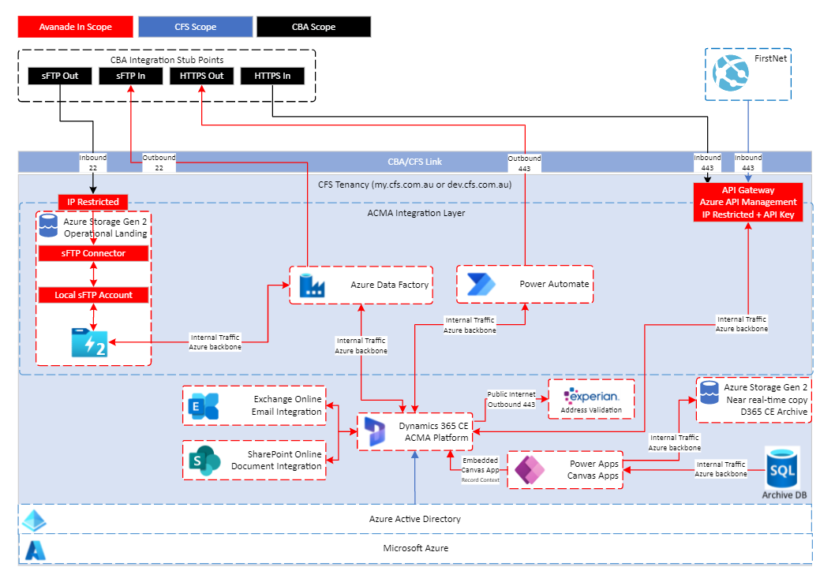
ACMA Architecture
Notes:
For applications with no active DR requirements, it is possible to specify EDC resources only. SDC resources can be added later if required.
Subnets can be specified at any size between /29 (Azure minimum) and the Vnet size. /24 is recommended for manageability. Further microsegmentation can be achieved through NSGs.
The GitHub project and repo is provisioned once and covers both Production and Non-Production tenants
Subscription level AD groups are intended for service principals only – user/dev RBAC should be set at the resource group level

Slide 5








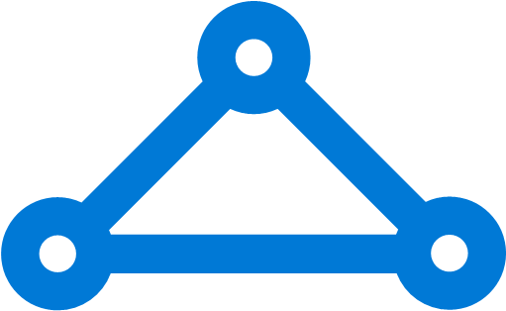

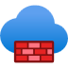




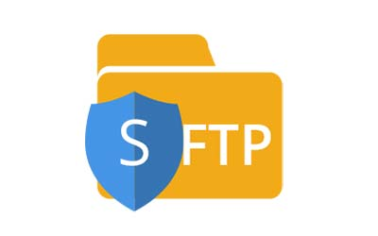
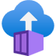
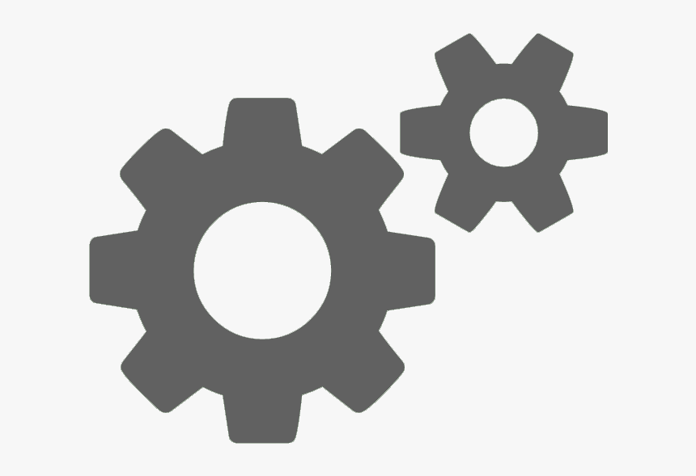
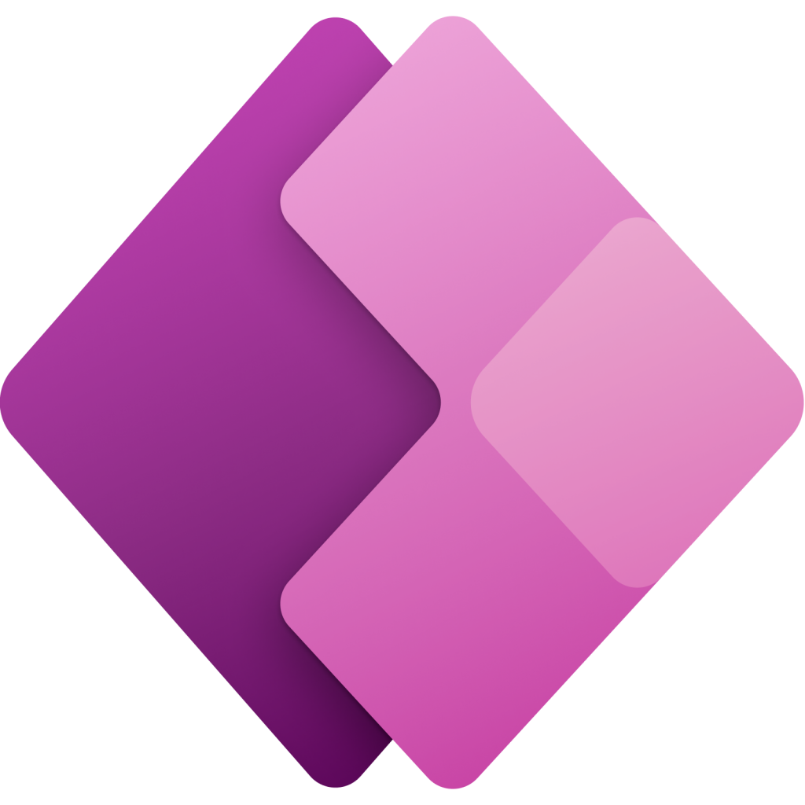





Network - Production (Operational State)
CFS Virtual Datacenter
Connectivity Hub
ACMA Landing Zone
CFS Tenancy
CoLo
ACMA VNET
Connectivity VNET
VNET
Peering
APIM Subnet
CBA
CFS
Private
Endpoint
NSG
UDR
APIM
FirstNet
SQL Subnet
BIS
ExpressRoute
GW
Data Subnet
FMS
Azure
Firewall
ADF
Data GW Subnet
Flow to be validated
Data GW Subnet
Data
Lake
Network Container
Microsoft Power Platform VNet service
Landing Zone Services
Shared Services
AD & DNS
Monitoring
Azure Policy
Security Center
Logging

Slide 6

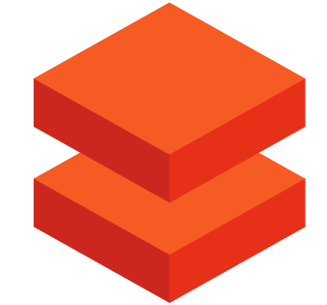
Network - Production (Operational State)
CFS Virtual Datacenter
Connectivity Hub
ACMA Landing Zone
CFS Tenancy
FNZ
ACMA VNET
VPN to be replaced by ExpressRoute
Connectivity VNET
VNET
Peering
APIM Subnet
Private
Endpoint
Azure
Firewall
NSG
UDR
APIM
FNZ
SQL Subnet
Internet
On Premises
VPN GW
Data Subnet
ADF
WRAP
Data GW Subnet
VNET
Peering
Data GW Subnet
Data
Lake
Data Subnet
Network Container
Microsoft Power Platform VNet service
Data Platform Project
Note: Data consumption pattern not yet designed
Data
Bricks
Landing Zone Services
Data Platform
Shared Services
AD & DNS
Monitoring
Azure Policy
Security Center
Logging

Slide 7


VDC Network Design
Australia East
ACMA VNET
Connectivity Hub
Data Platform VNET
Data Platform Project
Note: Data consumption pattern not yet designed
Bastion subnet
Jump Hosts
ACMA Migration VNET
Data Migration VNET
Data Migration Project
Gateway
Firewalls
ACMA VNET
Connectivity Hub
Data Platform VNET
ACMA Landing Zone
Bastion subnet
Jump Hosts
Data Migration VNET
Gateway
Firewalls
Australia SouthEast

Slide 8
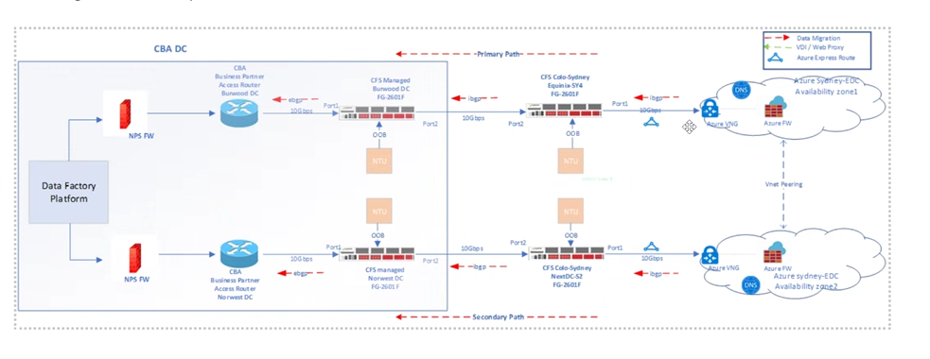
CBA to CFS Connectivity
Actually using static routes
Second cable on different port for non-prod

Slide 9
Network - Non-Production (Operational State)
CFS Tenancy
Placeholder
Data GW Subnet
Shared Services

Slide 10
Network Flows
Source | Destination | Port/Protocol | Path | Description
BIS | Data Lake | sFTP Port 22 | CBA > NPS Firewall > CBA Fortigate > CFS Fortigate> ExpressRoute > Azure Firewall> Data Lake > ACMA NSG > Private Endpoint > Data Lake | sFTP server access
FirstNet | APIM | HTTPs Port 443 | CBA > NPS Firewall > CBA Fortigate > CFS Fortigate> ExpressRoute > Azure Firewall> Data Lake > ACMA NSG > Private Endpoint > APIM > D365 | API Access to D365
FMS | APIM | HTTPs Port 443 | CBA > ExpressRoute > Colo > FortiGate > Azure Firewall > APIM > D365 | D365 Accesss
Data Factory (Data Lake) | BIS | sFTP Port 22 | ADF > Azure Firewall > ExpressRoute> CFS Fortigate> CBA Fortigate > NPS Firewall > CBA > BIS | sFTP client access
D365 | FMS | HTTPs Port 443 | Power Platform > PowerPlatform VNET > Data GW NSG > Network Container (SWIFT Tunnel) > Azure Firewall > ExpressRoute> CFS Fortigate> CBA Fortigate > NPS Firewall > CBA > FMS
FNZ | Data Platform Data Factory (Data Lake) | <TBD> | Data Platform ADF > Private Endpoint > Data Platform NSG > Azure Firewall > Fortigate > Internet > sFTP (FNZ)
Data Platform Data Factory (Data Lake) | ACMA Data Factory (Data Lake) |  | ACMA ADF > Azure Firewall > Data Platform NSG > Private Endpoint Storage Account
WRAP | Data Factory (Data Lake) | <TBD> | FNZ VPN > CFS VPN > Azure Firewall > Data Platform NSG > Private Endpoint Storage Account
Data Platform Data Factory (Data Lake) | ACMA Data Factory (Data Lake) |  | ACMA ADF > Azure Firewall > > Data Platform NSG > Private Endpoint Storage Account
Flow to be validated

Slide 11
Migration

Slide 12
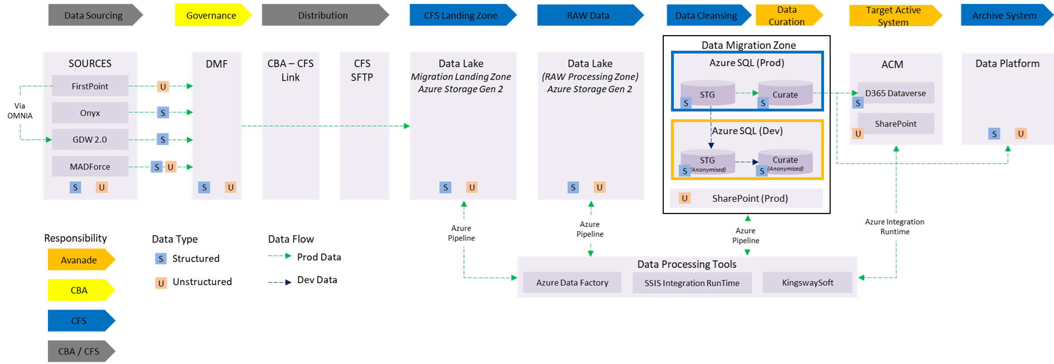
ACMA Architecture (Migration)
Data Migration Platform
ACMA
Notes:
For applications with no active DR requirements, it is possible to specify EDC resources only. SDC resources can be added later if required.
Subnets can be specified at any size between /29 (Azure minimum) and the Vnet size. /24 is recommended for manageability. Further microsegmentation can be achieved through NSGs.
The GitHub project and repo is provisioned once and covers both Production and Non-Production tenants
Subscription level AD groups are intended for service principals only – user/dev RBAC should be set at the resource group level

Slide 13
Network - Production (Migration)
CFS Virtual Datacenter
ACMA Landing Zone
CFS Tenancy
CoLo
Connectivity Hub
ACMA Migration VNET
DMF
CFS
Connectivity VNET
First Point
SQL Subnet
ONYX
Private Endpoint
Tumbleweed sFTP
GDW
NSG
UDR
ExpressRoute
GW
Data Subnet
MadForce
Azure
Firewall
ADF
Data GW Subnet
Data
Lake
Data Subnet
Data
Lake
Data Migration Project
Landing Zone Services
Data Migration Platform
Shared Services
AD & DNS
Monitoring
Azure Policy
Security Center
Logging

Slide 14
Network Flows (Migration)
Source | Destination | Port/Protocol | Path | Description
Data Lake | DMF (Tumbleweed) | sFTP Port 22 | Data Migration ADF > Private Endpoint > Data Migration NSG > Azure Firewall > ExpressRoute > CFS Fortigate > CBA Fortigate > NPS Firewall > Tumbleweed | sFTP server access for data migration
Data Platform Data Lake | ACMA Data Lake |  | ACMA ADF > Private Endpoint > Azure Firewall > Data Platform NSG > endpoint > Data Platform Data Lake

Slide 15
ACMA Landing Zone
(Azure resources)

Slide 16
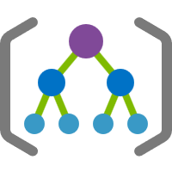
ACMA Landing Zone
Landing Zones - Prod
Landing Zones – Non Prod
Back Office
Digital Channel
ACMA
Back Office
Digital Channel
ACMA
CFS Wrap
First Net
SIT,
UAT,
TRN
CFS Wrap
First Net
DEV,
TEST
GOLDEN
PROD

Slide 17

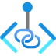
ACMA Landing Zone
EDC
SDC
APIM Subnet
APIM Subnet
Landing Zone resources:
4 resource groups in each of EDC & SDC containing
2 virtual network of range 10.x.y.0/16
4 subnets /24 in ACMA VNET
2 subnet /24 in ACMA Migration VNET
6 NSGs
2 UDR with default rules
2 key vault
2 storage account
2 Recovery Services Vault
1 platform infrastructure project and repository
Reader and contributor AD groups
Network peering to respective regional connectivity hubs
AD, DNS, PKI
Core IT monitoring, security, and support services
SQL Subnet
SQL Subnet
Geo-replica or replicated Backups
Data Subnet
ADF Subnet
MSFT Failover
to paired region
Data GW Subnet
Data GW Subnet
GZRS/GRS
ACMA VNET
ACMA Migration VNET
SQL Subnet
Data Subnet
Subscription
Landing Zone
Notes:
For applications with no active DR requirements, it is possible to specify EDC resources only. SDC resources can be added later if required.
Subnets can be specified at any size between /29 (Azure minimum) and the Vnet size. /24 is recommended for manageability. Further microsegmentation can be achieved through NSGs.
The GitHub project and repo is provisioned once and covers both Production and Non-Production tenants
Subscription level AD groups are intended for service principals only – user/dev RBAC should be set at the resource group level

Slide 18




ACMA Resource group Layout
ACMA
rg-xxx-storage
rg-xxx-security
rg-xxx-network
rg-xxx-compute
Storage Account
RSV?
ACMA VNET
ACMA Migration VNET
APIM
Archive
ACMA
Neal Realtime storage
Private Link / Endpoint
Staging
Curate
Migration
Raw processing
Network Security Groups
rg-xxx-storage
rg-xxx-security
rg-xxx-network
rg-xxx-compute
ACMA VNET
Storage Account
RSV?
Private Link / Endpoint
Network Security Groups

Slide 19
Resources
Type | Name | Environment | Function

Slide 20
PARKING LOT

Slide 21
Lifecycle view
Non-Production
Production
D365 CE Dev
Non Production Data
PII Cleansed & Obfuscated
D365 CE Prod
Production Data
D365 CE DM Dev &Test
Non Production Data
PII Cleansed & Obfuscated
D365 CE Test
Non Production Data
PII Cleansed & Obfuscated
D365 CE Training
Non Production Data
PII Cleansed & Obfuscated
D365 CE Golden
Only Configuration Data
D365 CE UAT
Non Production Data
PII Cleansed & Obfuscated
D365 CE SIT
Non Production Data
PII Cleansed & Obfuscated
21

